Slide 1
Thermal Energy Storage: Current Technologies and Innovations
Monday, January 22, 2024
Notes:
Samantha

Slide 2
During this session, the panel will discuss the latest innovations in thermal energy storage, incentives included in the Inflation Reduction Act of 2022, the economic and carbon-reduction benefits to end-users, as well as the benefits to the grid.
Moderator:
Samantha Slater, Air-Conditioning, Heating, and Refrigeration Institute
Speakers:
Boaz Ur, Nostromo
James Marker, Thule Energy Storage
Richard Mullen, EVAPCO
Paul Steffes, Steffes Corporation
Tom Vega, Baltimore Aircoil Company
Notes:
Samantha

Slide 3
Welcome and Introductions
Notes:
Samantha

Slide 4
Program
Introduction
What is thermal energy storage and why is it important?
Economic benefits
Grid benefits
Carbon reduction benefits
What types of thermal energy storage products are commercialized?
Latent ice storage systems (ice on coil, encapsulated ice)
Sensible chilled water, hot water, and high-temperature brick storage systems
Notes:
Samantha

Slide 5
Inflation Reduction Act (IRA) of 2022
Thanks to the IRA -- Now 30-40% Off!
Section 48 Investment Tax Credit
The provision extends the Section 48 energy investment tax credit (ITC), which allows taxpayers to claim a tax credit for the cost of energy property.
Thermal Storage: For thermal energy storage property, the provision provides a base credit rate of 6 percent and a bonus credit rate of up to 30 (plus 10% if domestic content) percent of the basis of energy property.
Projects qualify for the bonus rate if they meet prevailing wage and apprenticeship requirements.
The credit is available for thermal energy storage projects that are placed in service after December 31, 2022, and that begin construction before January 1, 2025.
Applicable to both public and private entities.
Notes:
Samantha

Slide 6
Boaz Ur Nostromo Energy

Slide 7
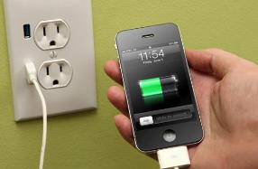
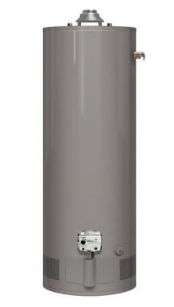
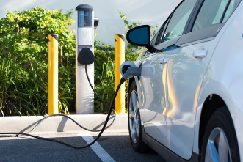
Definitions: We are familiar with Energy Storage
Electric
Thermal
Notes:
Guy

Slide 8
Definitions: Thermal Energy Storage (TES)
Thermal storage systems remove heat from or add heat to a storage medium for use at another time
Energy may be charged, stored, and discharged daily, weekly, annually, or in seasonal or rapid batch process cycles
Fast-acting and/or grid-interactive energy storage systems can provide balancing services and other critical needs of the electric grid
These grid-interactive systems dynamically couple consumer energy usage to the grid’s real-time needs
Thermal energy storage for HVAC and/or domestic water heating applications can involve various temperatures associated with heating and cooling
Notes:
Guy

Slide 9
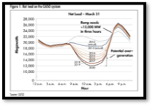
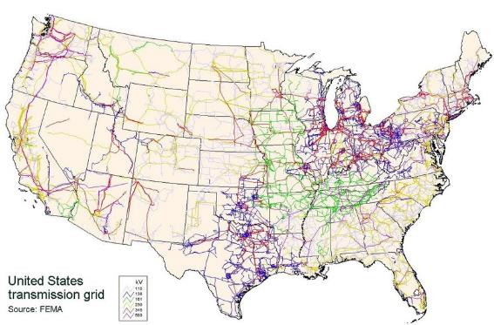
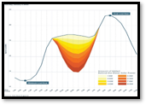
Grid Benefits
California – “Duck Curve”
Texas – Summer
Massachusetts – Winter
Notes:
Guy

Slide 10
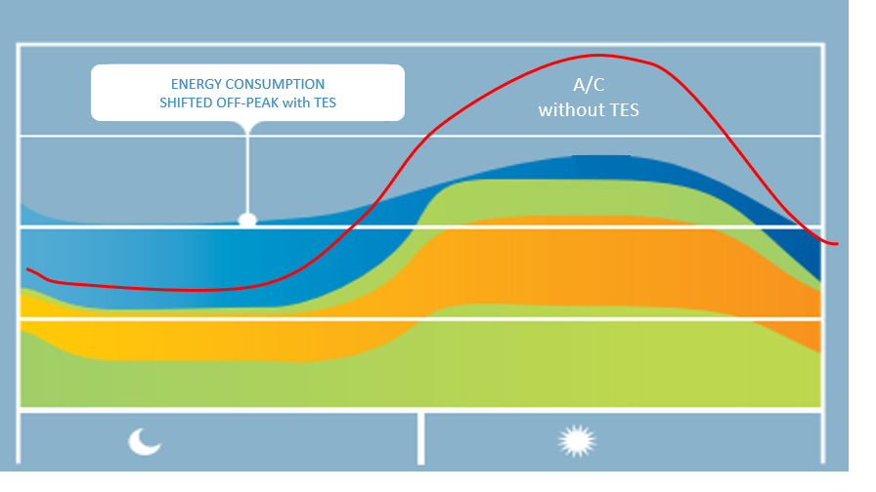
Grid Benefits
TYPICAL 24-HOUR LOAD PROFILE
A/C
LIGHTING
APPLIANCES & EQUIPMENT
ALL OTHER ELECTRICAL USES
OFF PEAK PEAK
Notes:
Guy

Slide 11
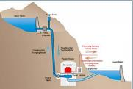
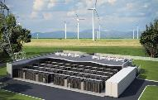
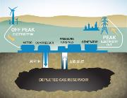
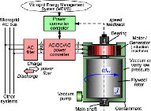
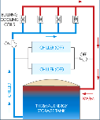
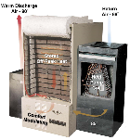
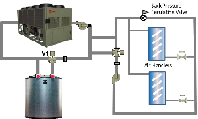
Energy Storage Technologies
Pumped Hydro
Battery
Flywheel
Compressed Air
Thermal Energy Storage (TES)
Chilled Water
Ice
High-temperature Brick

Slide 12
Comparison of Grid Scale Energy Storage
Energy Storage Useful Capital Costs
Technology Eff (%) Life (Yrs) ($/kWh)
Pumped Hydro 80 >25 165
Na-S Batteries 75 14 907
Lead-Acid Batteries 72 3 549
Li-Ion Batteries 86 10 469
Flywheels 86 >20 11,520
Compressed Air 52 25 105
Thermal Storage (TES) 93 - 100+ >50 30 - 500
Per DOE Report July 2019

Slide 13
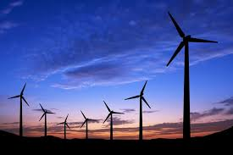
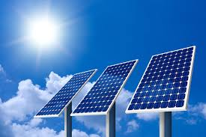
As more intermittent renewable power (wind and solar) is added to the electric grid… …more energy storage will be required to manage the imbalances between the supply and demand of electricity.

Slide 14
Economic Benefits for Owners
Reduce Energy Costs
Permanently reduce peak electric demand (kW)
Reduce time-of-use consumption costs (kWh)
Reduce peak electric consumption (by operating during cooler ambient conditions)
Utilize a more beneficial electric rate structure
Avoid Capital Costs
Instead of adding more refrigeration equipment – add a TES system instead
Instead of replacing an existing chiller – add a TES system instead
Manage Thermal Imbalances – store cold or hot water from a geothermal system, or capture waste heat from a combined heat and power system for later use
Provide Resiliency – utilize the TES system as a backup for mission critical operations

Slide 15
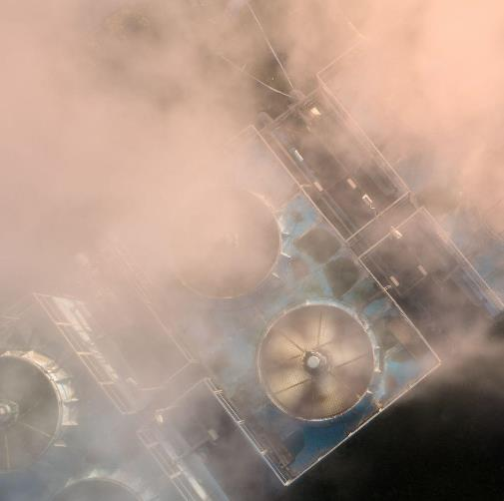
Buildings consume 74% of electricity
39% of Carbon
of which
Air Conditioning
at peak hours accounts for
30-70%
of total consumption

Slide 16
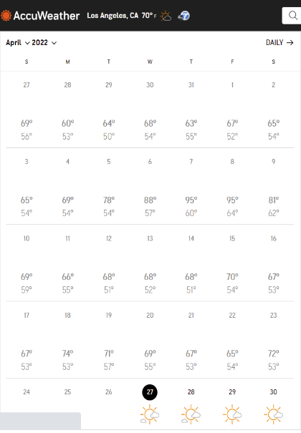
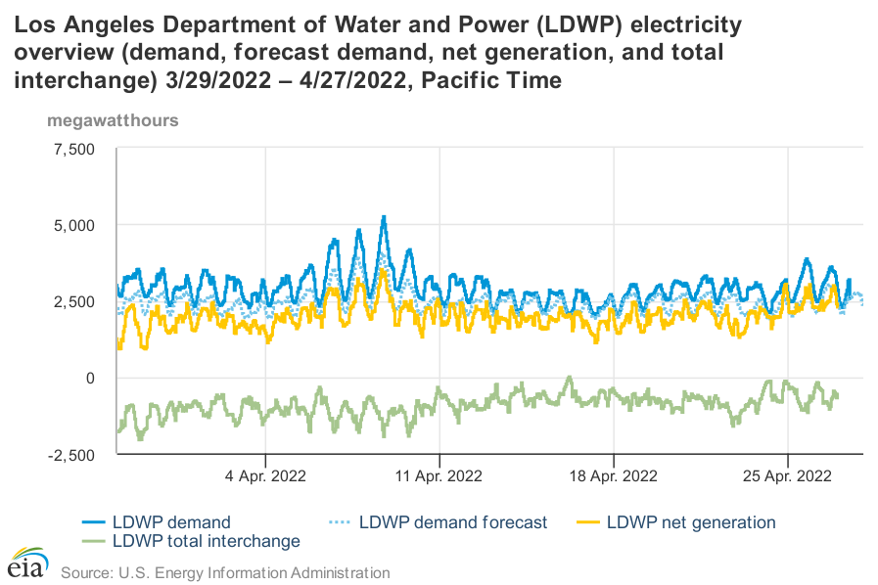
Load is driven by temperature

Slide 17
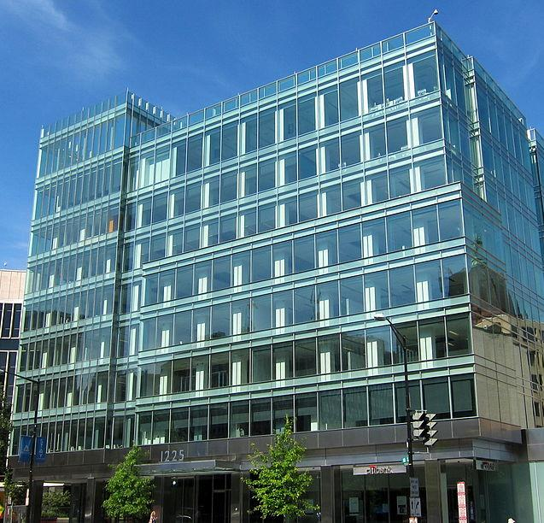
CUSTOMER BENEFITS
Free-up capacity to charge more EVs
+40% capacity
Up to
20
LEED points

Slide 18
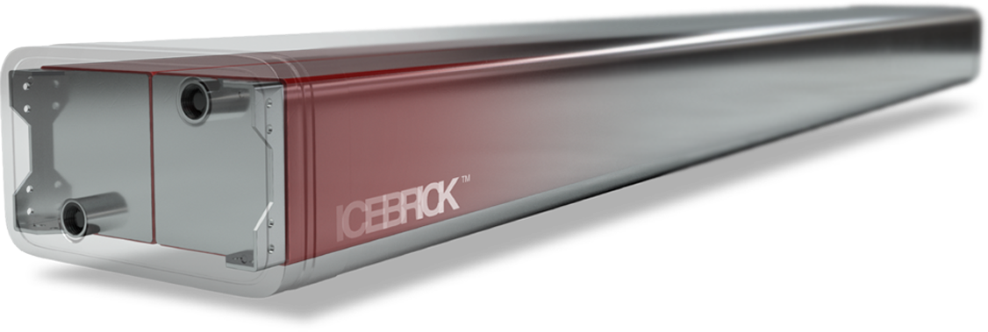
MODULAR ICE BATTERIES
Finally.
Safe, sustainable, modular
energy storage for pairing with chilled water systems.

Slide 19
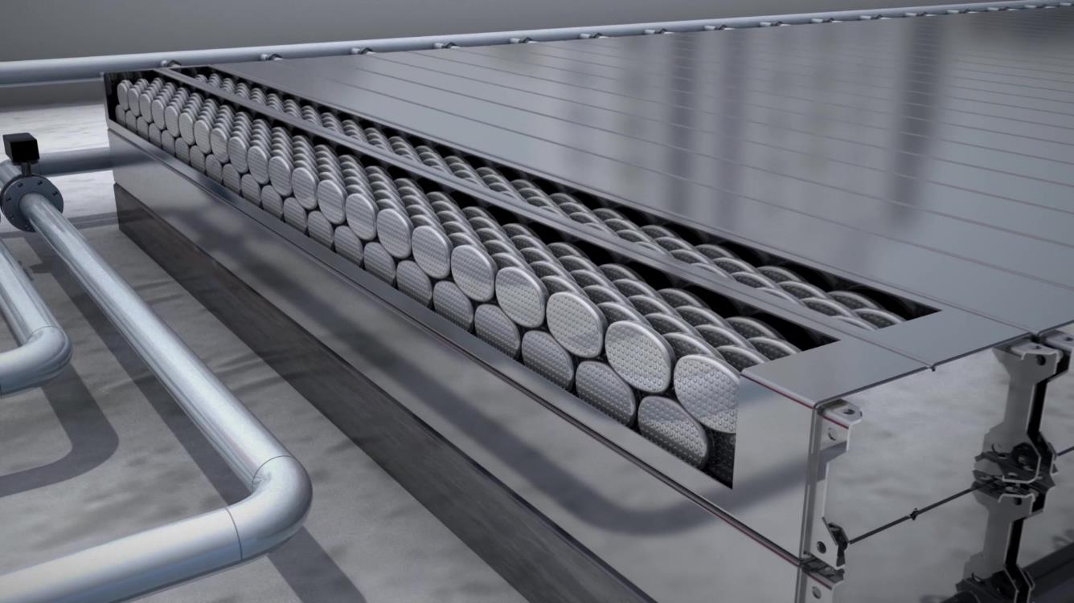
Encapsulated ICE
See it in Action
Nucleation
Notes:
The magic is in the encapsulated ice making the IceBrick the most efficient, fastest acting and sustainable form of ice storage on the market today.
Check out this short video.

Slide 20
MULTIPLE MARKETS
C&I To do their part
Versatile Applications
Promote environmental justice
Offices
Hotels
Industry
Government
50%
01%
Power consumption
Storage
Hospitals
Large Scale Retail
Education
Data Centers
Source: Woods Mackenzie, McKinsey.
244,500 chiller-cooled buildings in USA (excl. industry and data centers).

Slide 21
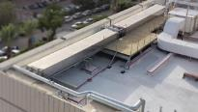
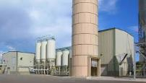
GROWING GLOBALLY
ELECTRA M&E
HVAC Integrator, Israel
Completed
MEDINOL
Medical Device, Israel
Completed
HOSPITAL**
TBA (Government)
Expected 2024
DATA CENTER**
Partner TBA
Expected 2024
200 kWh
500 kWh
1,200 kWh
1,100 kWh
BEVERLY HILTON*
Visitor Center, CA
Coצmmisioned Q3/2023
SANDSTONE*
Office Building, LA
All permits received
AB Inbev*
Baldwinsville, NY
Expected 2024
FILM STUDIOS**
TBA, CA
Expected 2024
1,200 kWh
900 kWh
1,000 kWh
2,000 kWh
* In design/construction
** In contract/negotiations
Notes:
Here’s a few examples in hotels, commercial buildings, hospitals, breweries, universities, even campuses.

Slide 22
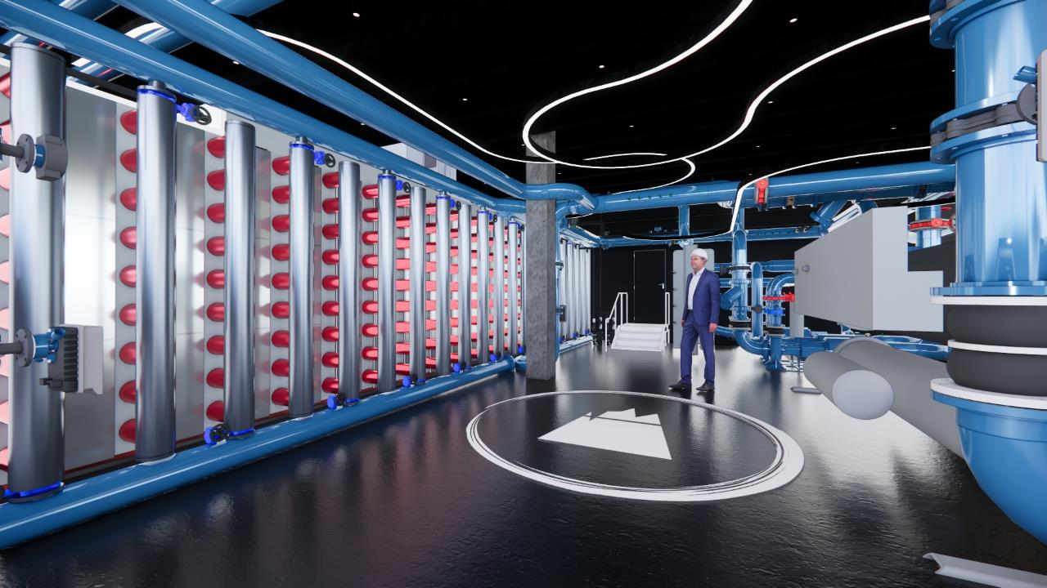
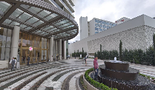
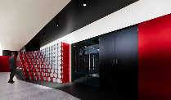
Hilton Beverly Hills System

Slide 23
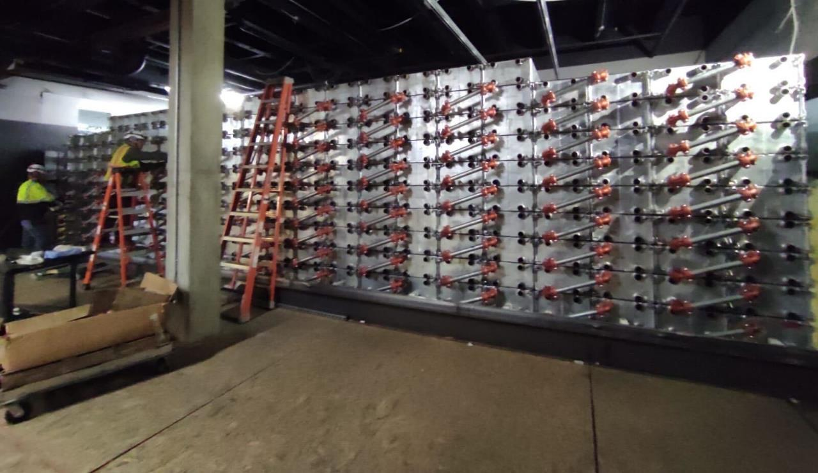
Hilton
Beverly Hilton System. 198 Bricks, 1.2 MWH already in the room.

Slide 24
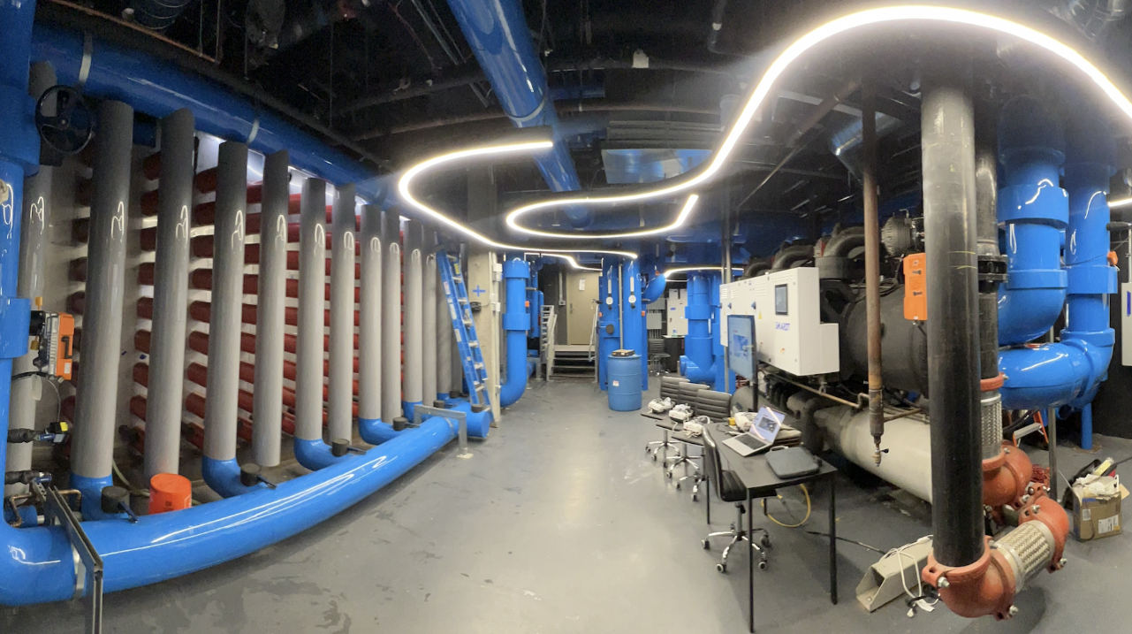
Notes:
This is the system from the inside

Slide 25
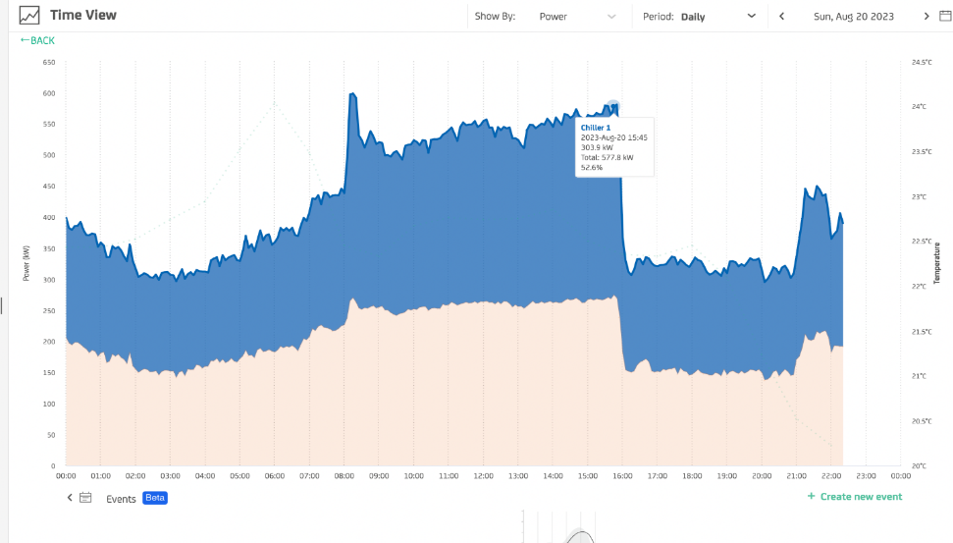
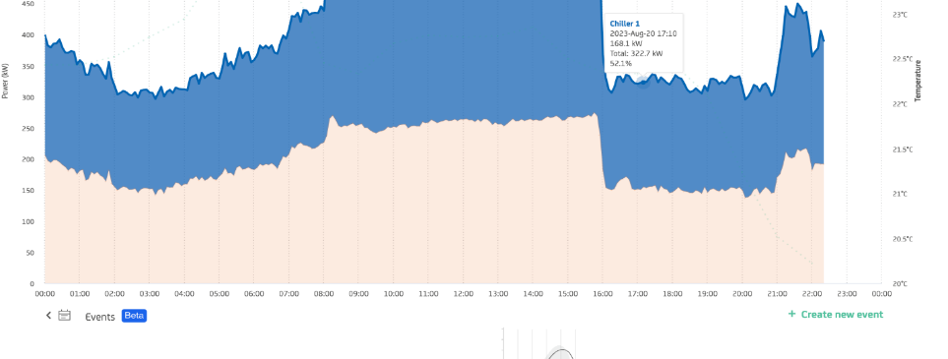
August day - Demonstrated a 256kW demand reduction
579kw
-
323kw
256kw

Slide 26
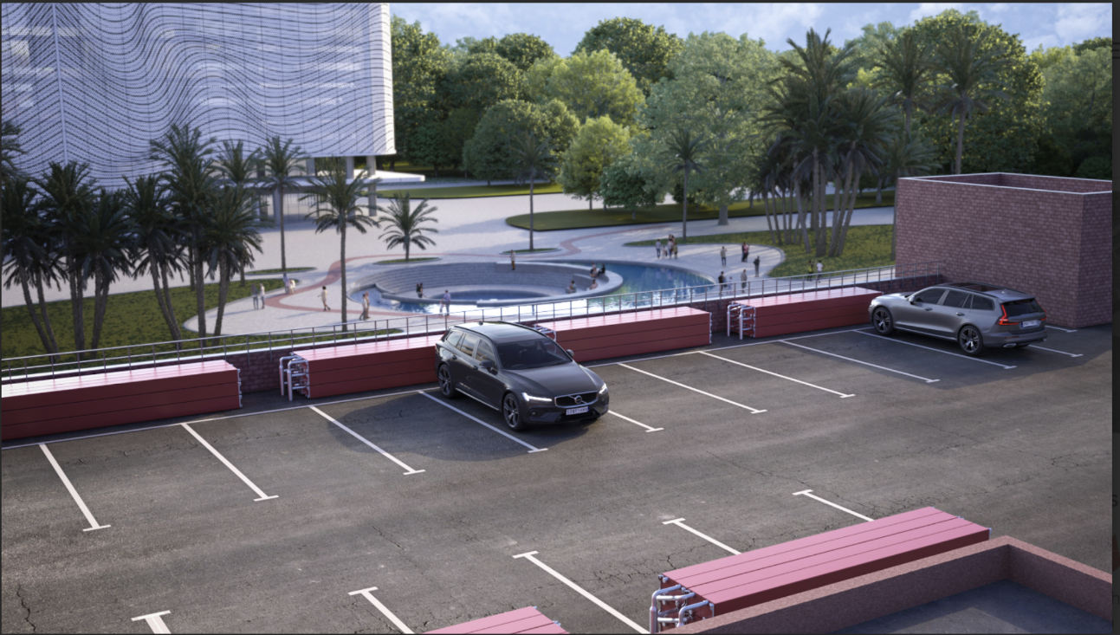
Notes:
Parking lots, can (and probably should) be paired with solar canopies

Slide 27
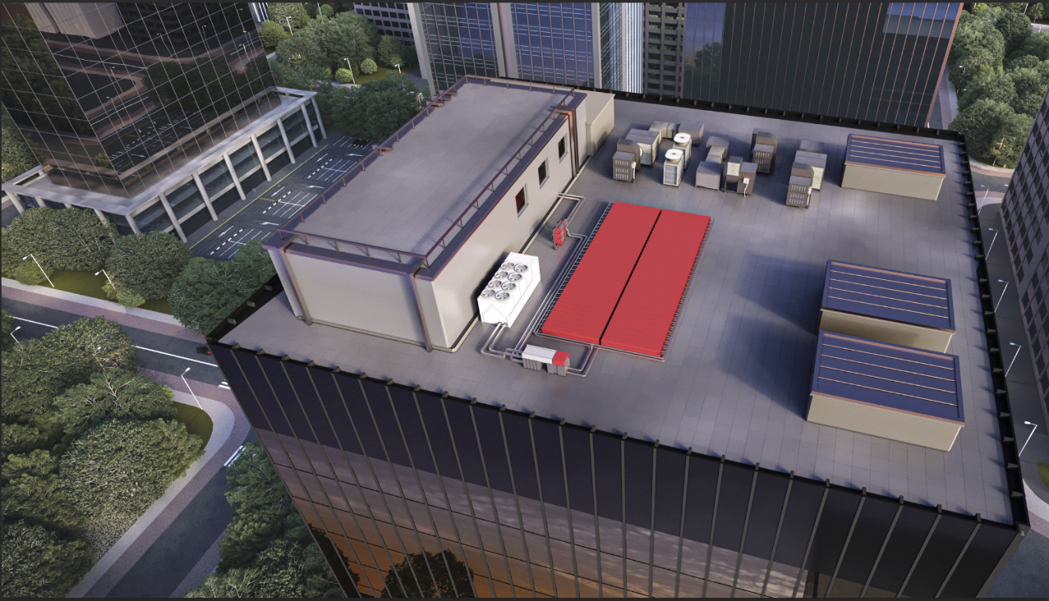
Public Spaces
Positioning

Slide 29
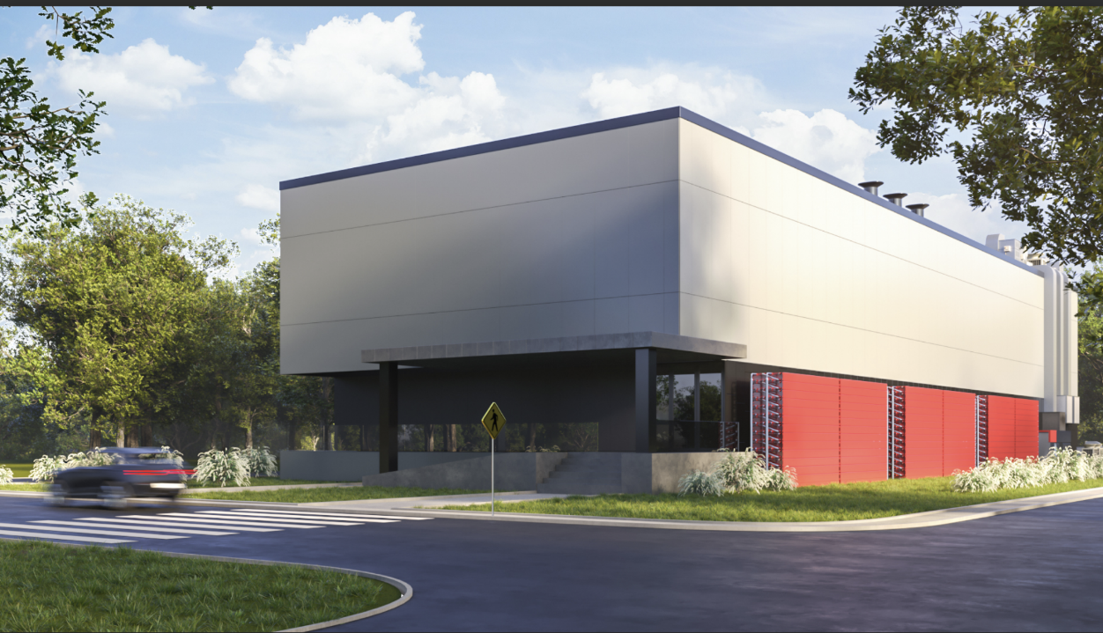

Slide 30
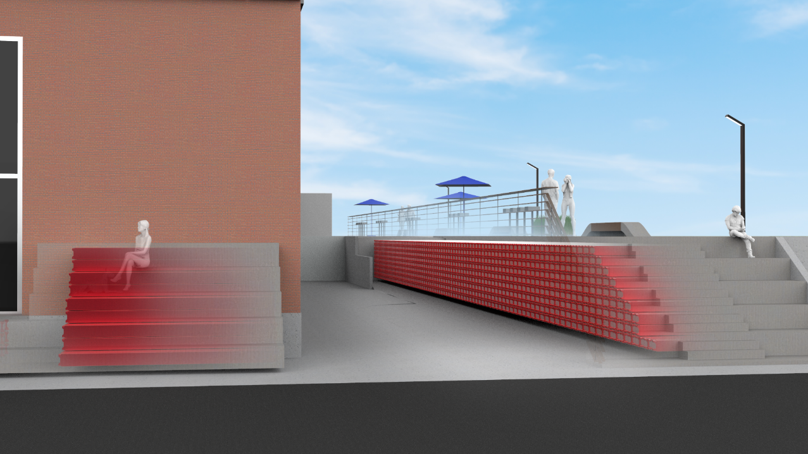
Public Spaces
Index Slide
Notes:
700 IceBrickTM units designed as sitting benches for the students.

Slide 31
James Marker Thule Energy Storage

Slide 32
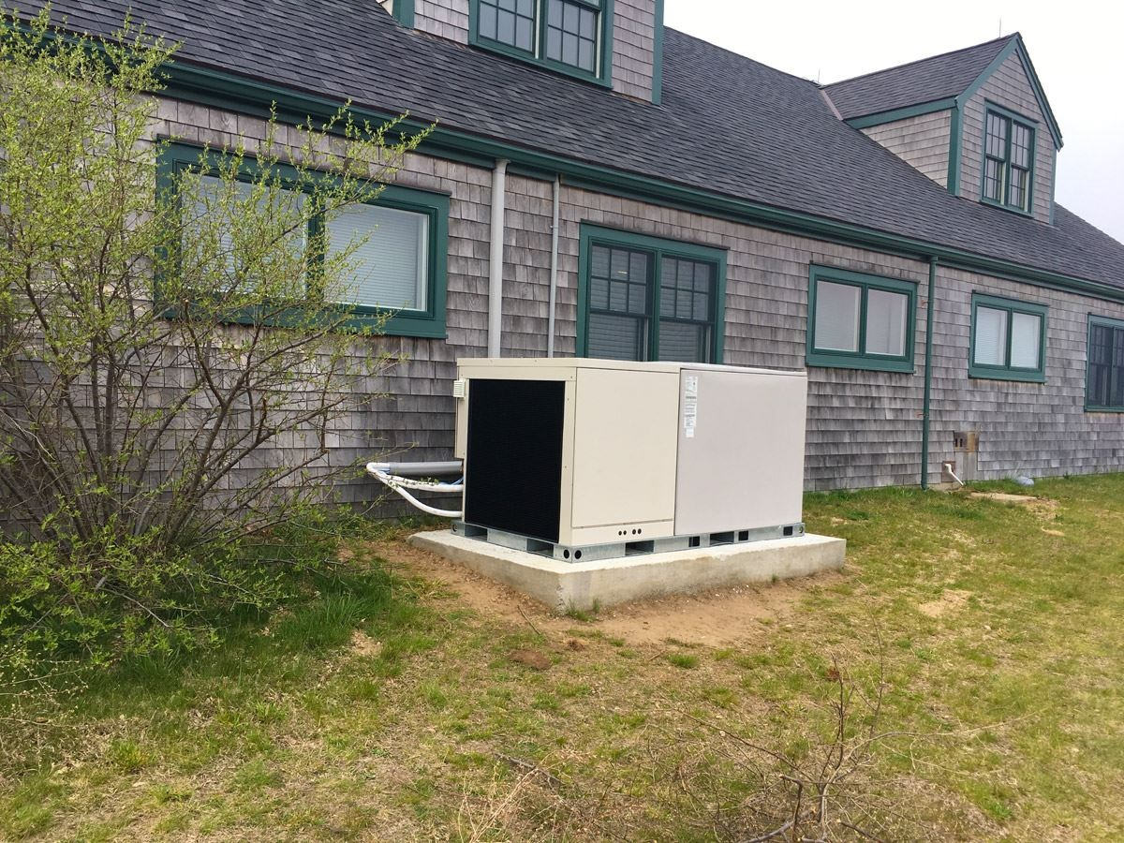
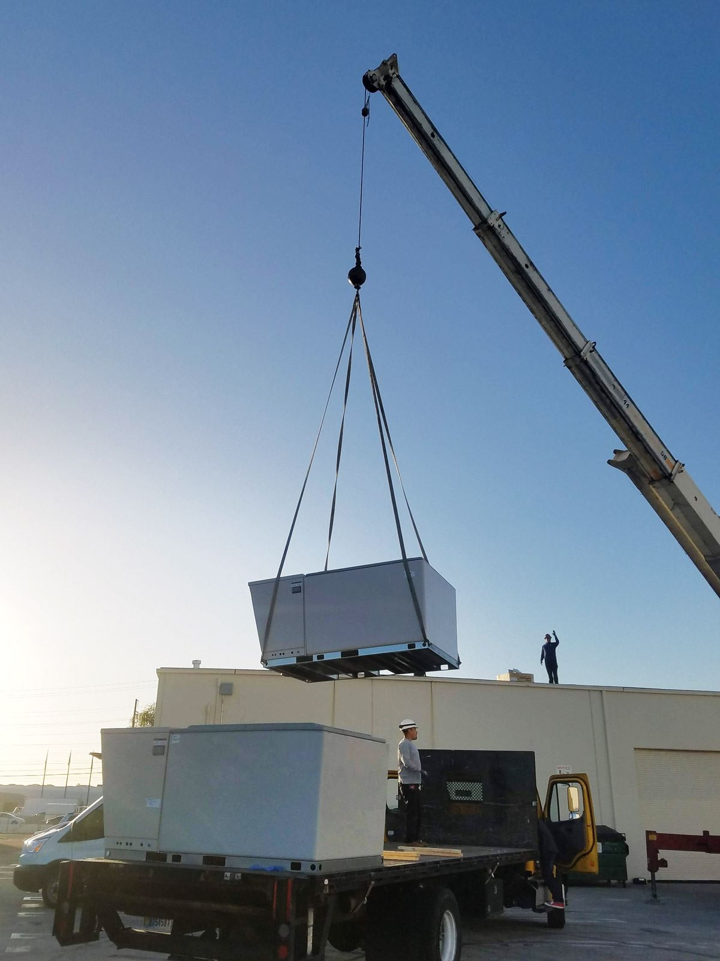
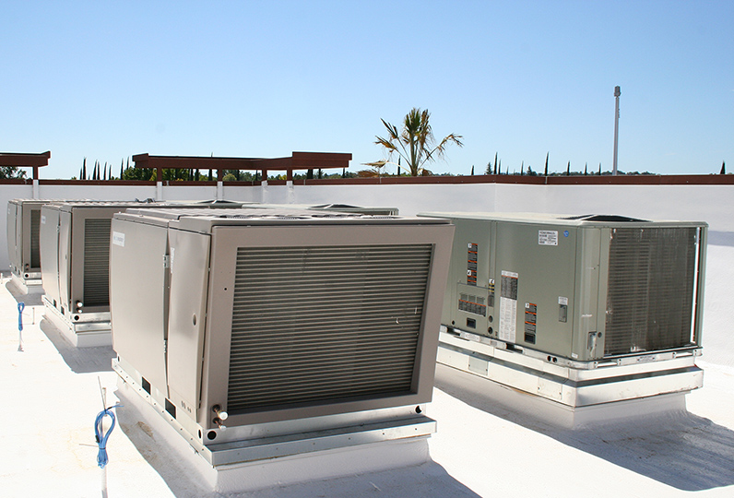
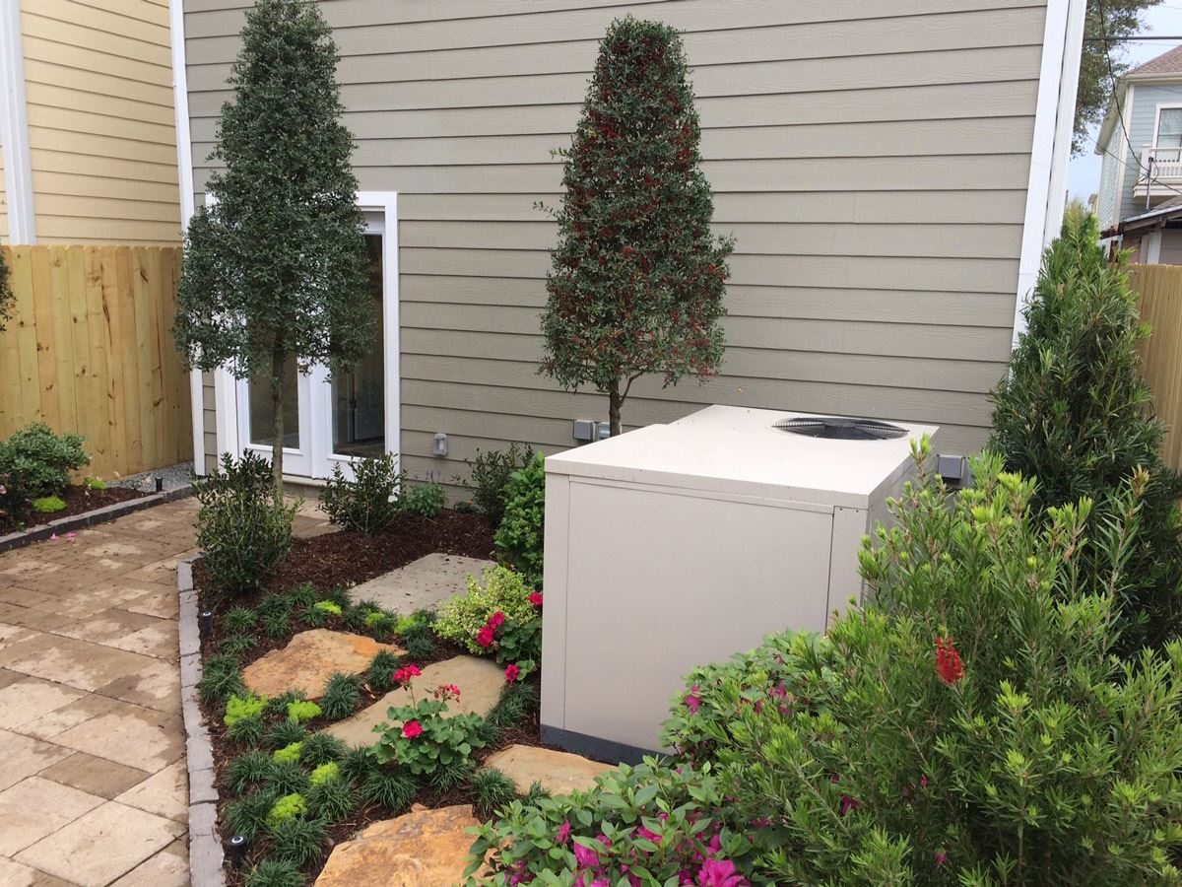
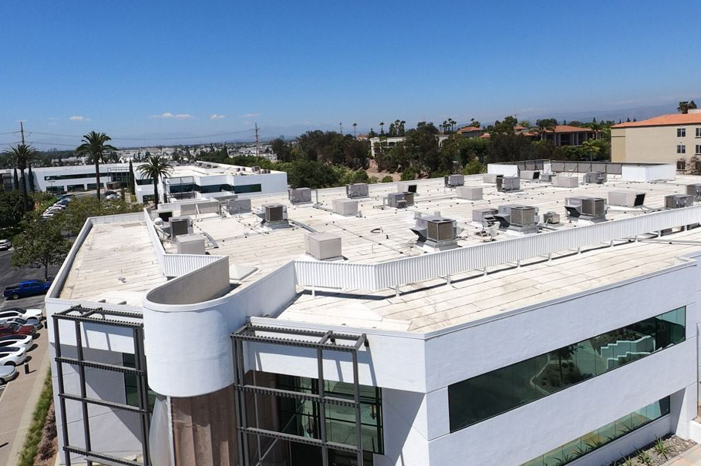
Ice Storage in Residential and Commercial
Notes:
Wei-Tai Kwok
My focus will be on how TES is being deployed in residential and commercial rooftop applications.
From Nantucket, MA to Houston TX, to Southern California.
PICTURES: Commercial Rooftop Packaged Units under 25-tons & Residential units

Slide 33
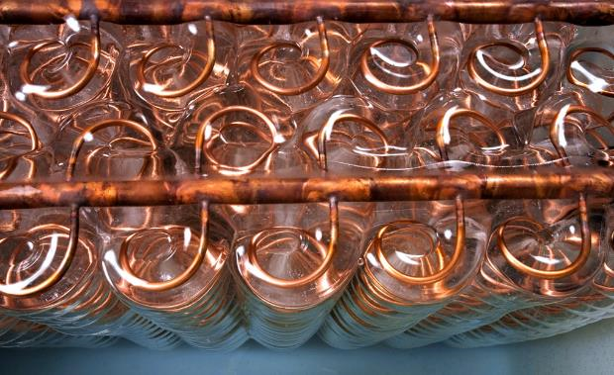
Ice Cold Inside
Notes:
Wei-Tai Kwok
Ice-on-Coil

Slide 34
How It Works it works

Slide 35
TES
HVAC
Notes:
Wei-Tai Kwok
Example of a 20-ton HVAC connected to TES on a big box store type of application.

Slide 36
Thermal storage paired with a residential air conditioner

Slide 37
Before vs. After TES installation (in kW)
kW
Time of Day
Notes:
Wei-Tai Kwok
A sample commercial site's electricity profile prior to TES installation.

Slide 38
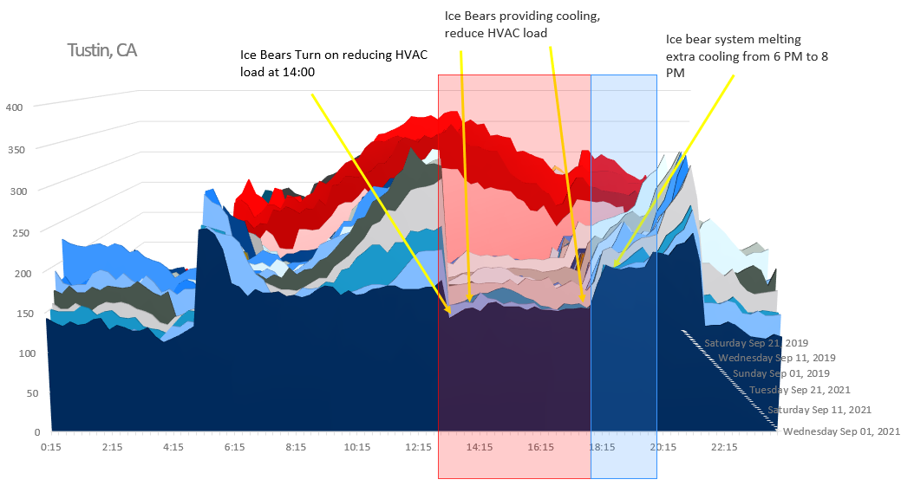
Before vs. After TES installation (in kW)
Notes:
Wei-Tai Kwok
A sample commercial site's electricity profile AFTER TES installation.

Slide 39
TES – Deployment Benefits
Experience going direct-to-utility through PPAs
Allows for utility flexibility to either hand off to third party or act as point of contact for end use customers.
Utility able to schedule deployment of HVAC assets of thermal storage resources.
Utility bill reductions and increased grid resiliency to disadvantaged communities
Flexible Utility Program Management
Collaboration with Social Service Agencies
Trade relationships with major HVAC OEM manufacturers
Midstream wholesalers, and Contractor Networks

Slide 40
Richard Mullen EVAPCO Inc.

Slide 41
Ice Thermal Energy Storage is a problem solver
Limited Available Space
Premium Real-Estate Costs
Back-up Cooling
Plus, Many More Solutions
Small to Large and Everything In-Between

Slide 42
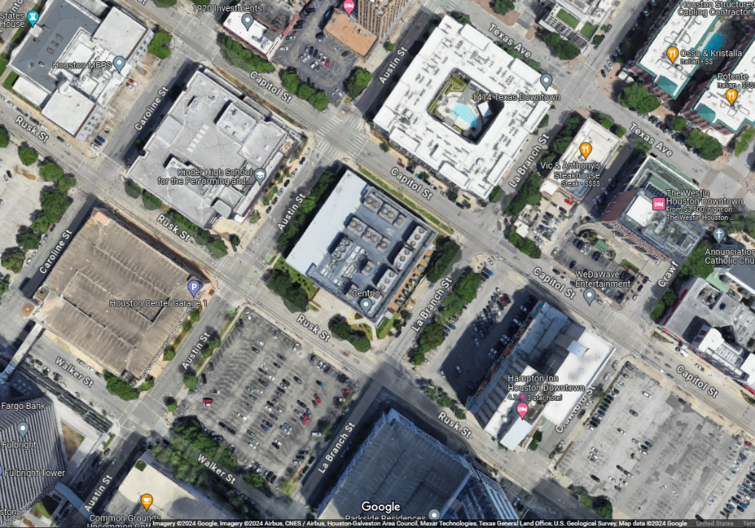
District Cooling Plant, Texas 88,000 Ton-Hours
180ft
49ft x 147ft
39ft H
Ice Storage
Chilled Water Storage
180ft
59ft H
180ft D x 52ft H
Chilled Water Storage is 6 to 8 times LARGER than
Ice Storage
Image from Google Maps

Slide 43
Costly Real-Estate
Land required
50ft x 148ft =7,400ft²
Cost of land @$55/ft²
$ 407,000.00
180ft
49ft x 147ft
39ft H
Ice Storage
Chilled Water Storage
Land required (π90ft²)
=25,446ft²
Cost of land
@ $55/ft²
~$ 1,400,000.00
180ft
59ft H
180ft D x 52m H
Estimated Saving on Real Estate
~$ 993,000.00
Image from Google Maps

Slide 44
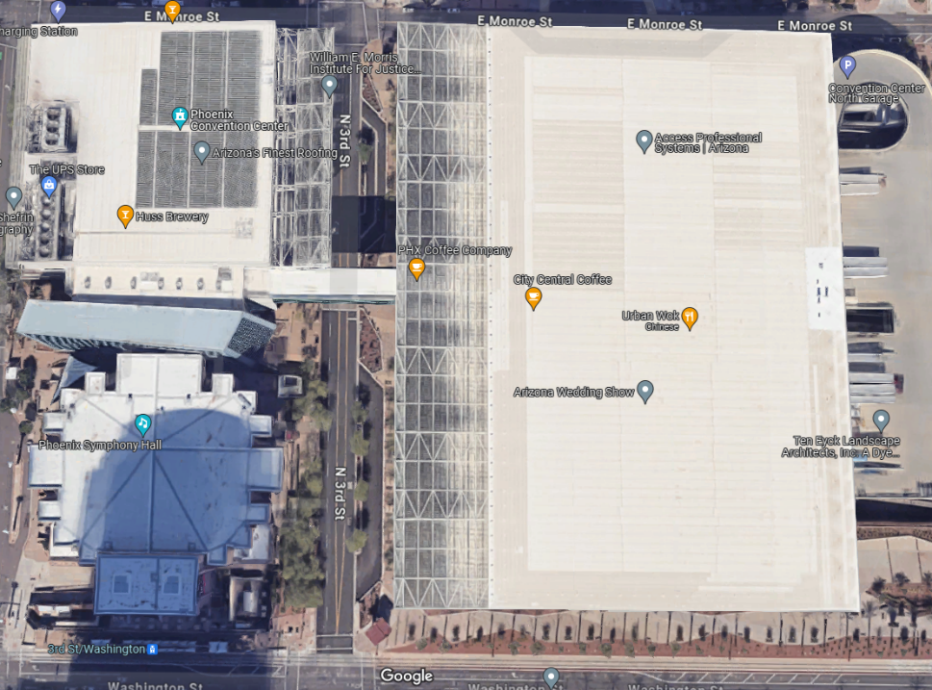
Limited Available Space
Phoenix, Arizona
Convention Center
Ice plant located a few levels below road surface.
Ice Storage capacity
36,480 Ton-hrs
Ice Storage Plant
Image from Google Maps
https://www.google.com/maps/@33.4487796,-112.069804,428a,35y,359.06h,8.9t/data=!3m1!1e3?authuser=0&entry=ttu

Slide 45
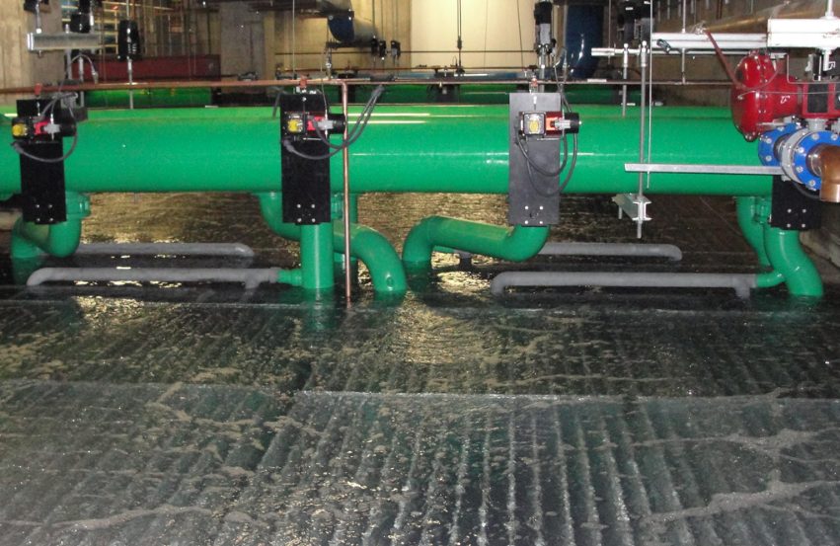
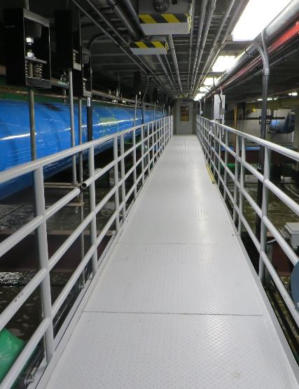
Storage Capacity 36,480 Ton-hours

Slide 46
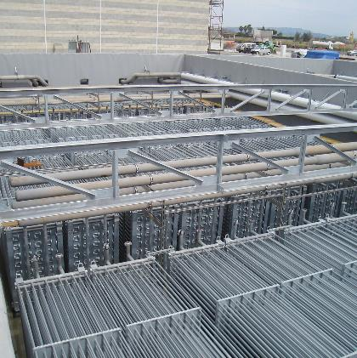
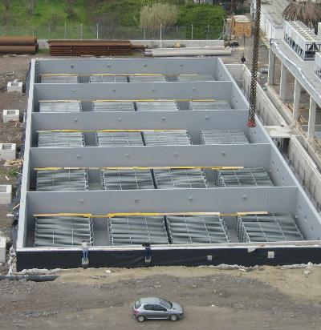
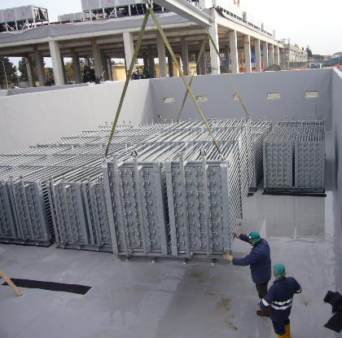
Emergency Backup Cooling for 48 hours
Storage Capacity = 34,129 Ton-hrs

Slide 47
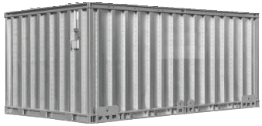
Small to Larger and Everything in-between
Modular tanks from:
370 - 1,000 Ton-hours per tank
4,000 Ton-hours & above, steel ice coils in a concrete.
Reduced space requirements
Easy operation
Simplified monitoring
Our largest installation to date ~127,000 Ton-hours.
There is NO Upper Limit

Slide 48
King Abdul Aziz University Central Utility Plant - Jeddah, Saudi Arabia
Total Storage Capacity = 126,848 Ton-hours

Slide 49
Paul Steffes, PE Steffes ETS

Slide 50
DISPATCHABLE, HIGH-TEMPERATURE (DHT) THERMAL ENERGY STORAGE BATTERIES
Distributed, but when aggregated grid-scale Thermal Energy Storage
Dynamically pairs heating to the needs
of the grid
Enables renewable integration
Flexible loads for carbon reduction
WIN-WIN-WIN for Owner-Grid-Environment
15 to 480 kWh storage capacity

Slide 51
Commercial Hydronic Furnace 6.7 MWh Storage
480 kWh/ Unit

Slide 52
Courthouses, Schools & Historic Buildings
Courthouse = 75 Room Units
Law Enforcement Center = 7 Hydronic Furnaces
12 to 40kWh/ Unit
120 to 240kWh/ Unit

Slide 53
DHT Batteries with Ductless Heat Pumps in Urban Apartment Buildings
DHT Thermal Energy Storage + Heat Pumps offer significant benefits:
Provide great comfort 24 hours a day
Optimize system performance by allowing the heat pump's efficiency to be fully utilized
Off-peak or load-control rates save money on heating and overall energy costs
Suitcase size 12 to 40kWh/ Unit

Slide 54
Optimize efficiency of heat pumps in cold weather with DHT Thermal Energy Storage
Comfortable Discharge Air
Return Air
Stored Heat
240 kWh heat storage
Heat Pump Coil
Heat Pump Conditioned Air
Some Heat Added
as Needed
Pictured with 80 kWh heat storage and 3-ton HP

Slide 55
Optimize efficiency of heat pumps in cold weather with DHT Thermal Energy Storage
Thermal energy storage optimizes the operation and comfort of the air-to-air heat pump.
Need for some extra heat
here for comfort
Stored thermal energy replaces strip heat with lower carbon footprint alternatives.
Need for some extra heat
here for defrost

Slide 56
A Fantastic Carbon Reduction Technology
Thermal energy storage has the potential to virtually eliminate carbon for heating and cooling buildings.
https://www.epa.gov/ghgemissions/inventory-us-greenhouse-gas-emissions-and-sinks-1990-2020 Annex 1 and Figure ES-16

Slide 57
Using Active Controls to Dispatch Charging
Provides Greater Value
Active controls provide dispatchability to meet
real-time needs of the grid today and in the future
Follows the real-time up and down needs of all parts of the grid
Ensures every building and occupant has energy when needed
Provides visibility, controllability, and verification to the grid operator
Thermal energy storage is a true battery, providing predictable and verifiable up-and-down regulation of the grid

Slide 58
Dispatching Flexible Loads to Match All Grid Variabilities
MW(electric)
MW(electric)
Hourly dispatch set day-ahead
with generation, load, and market forecast
Hourly dispatch set Day-ahead
with generation, load, and market forecast
MW(thermal)
MW(thermal)
Discharge
Delivery of hot water and space heat
Dispatch adjustments
made to meet real-time conditions on the grid
Discharge
Delivery of hot water and space heat
Dispatch adjustments
made to meet real-time conditions on the grid
All storage is full
MWh(thermal)
All storage is full
MWh(thermal)
State of Charge
Minimum Aggregate Storage Level
State of Charge
Minimum Aggregate Storage Level
Compressor could be controlled in
Critical Peak times
If needed

Slide 59
Tom Vega Baltimore Aircoil Company

Slide 60
Common motivators for thermal storage
ROI difference between day/night utility rates
Demand charge avoidance
Incentive awards
LEED Points/sustainability initiatives
Emergency standby
Reduce chiller/cooling tower size

Slide 61
Common Ice TES Applications
Application Type | Ice TES Technology Type
High Rise Buildings | Internal Melt
Office Building | Internal Melt
Schools K-12 | Internal Melt
Universities | Internal or External Melt
Convention Centers and Stadiums | Internal or External Melt
Hospitals | Internal or External Melt
Data Center Emergency Standby Cooling | External Melt
District Cooling | External Melt
Batch Process Cooling *** | External Melt
Used most commonly when night load is low relative to day time load.

Slide 62
Internal Melt Principle of Operation
Internal Melt Ice on Coil
COLD
GLYCOL
OUT
WARM
GLYCOL
IN
Cold glycol inside coil builds ice
Warm glycol inside coil melts ice
Closed system
Typical for smaller systems and systems with longer meltouts.
ICE ON COIL
MELTING OCCURS
FROM INSIDE
ICE
W A T E R
WARM GLYCOL
Primarily used on systems < 10,000 ton-hours

Slide 63
External Melt Principle of Operation
External Melt Ice on Coil
AIR
WATER
OUT
WATER
IN
Cold glycol inside coil builds ice
Water circulates through the tank
Open system
Typical for district cooling systems and quick-melt applications.
ICE ON COIL
MELTING OCCURS
FROM OUTSIDE
ICE
REFRIGERANT OR GLYCOL
Primarily used on systems > 10,000 ton-hours

Slide 64
CenTrio Chicago Ice Storage System
Over 310,000 ton-hours across (5) plants
Serves over 115 buildings in downtown Chicago
Cools a combined 53M square feet of building space

Slide 65
Internal Melt Ice Thermal Storage
Bristol Myers, Lawrenceville, NJ
6,849 ton-hours
388-390 Greenwich, New York City, NY
8,371 ton-hours
Internal melt selected for LEED status, incentive awards, and longer melt out rate.

Slide 66
External Melt Ice Thermal Storage (cont.)
Nova Southeastern University, Ft. Lauderdale, FL
79,200 ton-hours
External melt selected for long pipe runs, incentive/TOD rates, and quicker melt out rate.

Slide 67
Thermal Storage Tank Designs
Modular tanks for both internal and external melt
Thermal storage coils for both internal and external melt placed into Field erected tanks
Field erected tanks can be used to optimize usable space.

Slide 68
Questions?
Chilled or Hot Water Tanks for Campus-size Applications
Commercial & Industrial:
Ice Thermal Storage
Commercial & Industrial:
Encapsulated Ice
Commercial & Residential:
Ice Energy Storage
Commercial, Residential & Multi-Family:
High Temperature Brick

Slide 69
Thank you for joining us! Please contact Samantha Slater at AHRI for additional information (sslater@ahrinet.org)
Notes:
Samantha

